Slide 1


league of legends

Slide 2
The rise of LOL
League of legends was the most popular game in China between 2013 and 2015.
The success of it is due to strong social values.people play League of legends to fit in.
Competitivity and cooperation are the essential cores of league of legends.

Slide 3

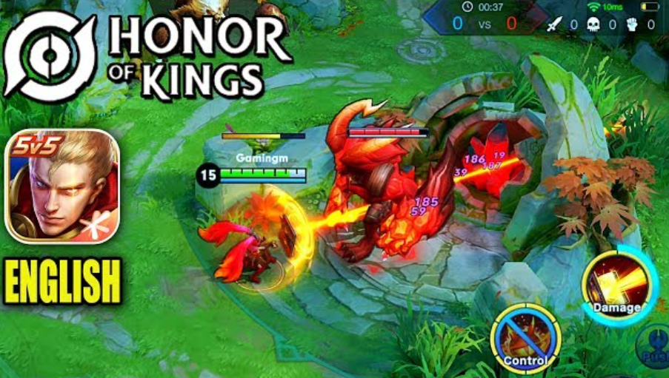
The fall of LOL
One of the critical reasons that caused the fall of LOL is social means shifting to mobile phones.
Honor of kings is a substitute for LOL on the mobile platform.
TikTok is another convenient way to consume time everywhere and at any time.

Slide 4
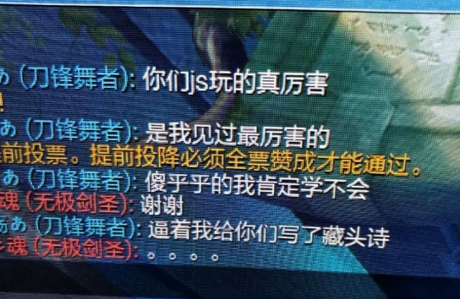
The toxic atmosphere in LOL
Verbal abuse in LOL is one of many common phenomenon that causes the toxic atmosphere.
Players abuse each other even over triffles with organs and mothers.
AFK and LTG are also commom in game.

Slide 5
The causes of the atmosphere
Comparison is the main cause of the atmosphere
1. League of Legends is a game in which cooperation and competition are essential cores of it.
2. In the comparison atmosphere in China, competition part is considered more important than cooperation.
3. That is to say, comparison is the way to self-identity, I am better than others. When losing a game means failing to construct the image of I that fits the comparison order.

Slide 6
The causes of the atmosphere
Comparison is the main cause of the atmosphere
4. In order to fit in the order again, hysteric subjects win in a perverted way in which negativity is the core of it. - I lose the game not because I am incapable, it is due to the teammates’ terrible performance, or not fully exerting my power.
5. As a result, League of legends is a game in which win is the only option, whether in positive or negative ways.

Slide 7


The comparison oder
1.By comparing, one finds his position in a symbolic order, comparing satisfies the pleasure of the big other(God).
2.Subjects are hysteric, they don’t know what the big other wants from them, anxiety drives them to satisfy the big other, but only find it is unsatisfied.
3.Losers have to win in the order, but in a negative way, losers are winners.

Slide 8

WIN-RATE Team
Win-rate team is a team with more than 80% win rate.
Each team member specialized in their own position.
Some Win-rate teams consist of 1~2 clients and 3~4 master or challenger level servants, their goal is to increase their clients’ win rates to satisfy their clients' vanity.

Slide 9
What do you think of WR team?

Slide 10
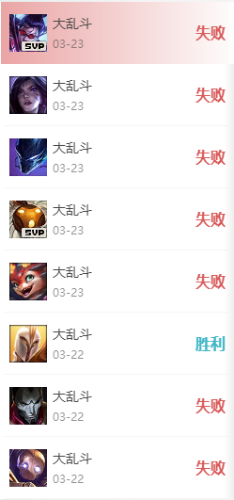
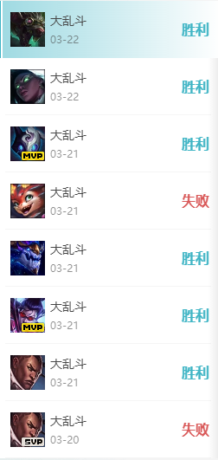
Elo rating system
Elo rating system is a system to violently regulate players' win rates. A win streak causes a loss streak, in other words, one loses because the system needs one to lose.
The system is a great example of gambler psychology in which when a loss streak triggers, gamblers want to win back their loss, consequently lose more.
The system is also a crucial reason that causes the negative behaviors of players.

Slide 11
The future of Moba
League of legends players keep decreasing over time, and will remain on a small scale.
Moba genre will still be a popular genre because of its competition and cooperation. However due to online games particularity, only a few moba games are popular, and most merely survive.
Honor of Kings keeps dominating Moba games market in China since Tencent owns the major flows.

